Slide 1



Repco Home Finance (NSE – REPCOHOME)
20-20 Investing Accelerator Summit
Date: 23rd Aug’24
www.katalystwealth.com

Slide 2
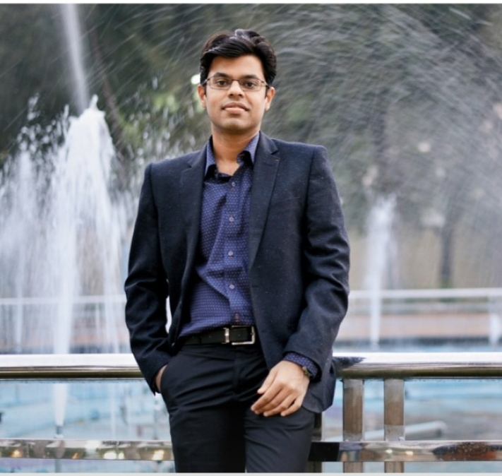
About me
Ekansh Mittal
Founder, Katalyst Wealth
(www.katalystwealth.com)
SEBI Registered Research Analyst
www.katalystwealth.com

Slide 3
Disclaimer
www.katalystwealth.com (here in referred to as Katalyst Wealth) is the domain owned by Mittal Consulting. Mr. Ekansh Mittal is the sole proprietor of Mittal Consulting and offers independent equity research services to Investors on subscription basis. SEBI (Research Analyst) Regulations 2014, Registration No. INH100001690. BSE Enlistment No. 5114.
This is not an offer to sell or solicitation to buy any securities and Ekansh Mittal/Mittal Consulting/Katalyst Wealth will not be liable for any losses incurred or investment(s) made or decisions taken/or not taken based on the information provided herein.
Address - 7, Panch Ratan, 7/128, Swaroop Nagar, Kanpur - 208002, Contact No. - +91-7275050062, Compliance Officer - Mr. Ekansh Mittal, +91-9818866676, Ekansh@katalystwealth.com, Grievance Redressal - Mittal Consulting, grievances@katalystwealth.com, +91-9818866676, +91-7275050062
“Registration granted by SEBI and certification from NISM in no way guarantee performance of the intermediary or provide any assurance of returns to investors”. “Investment in securities market are subject to market risks. Read all the related documents carefully before investing.”
Disclosure SEBI (RA) Regulations
Whether the research analyst or research entity or his associate or his relative has any financial interest in the subject company/companies and the nature of such financial interest – Yes
Whether the research analyst or research entity or his associates or his relatives have actual/beneficial ownership of 1% or more securities of the subject company (at the end of the month immediately preceding the date of publication of the research report or date of the public appearance) – No
Whether the research analyst or research entity or his associate or his relative has any other material conflict of interest at the time of publication of the research report or at the time of public appearance – No
Whether it or its associates have received any compensation from the subject company in the past twelve months – No
Whether it or its associates have managed or co-managed public offering of securities for the subject company in the past 12 months – No
Whether it or its associates have received any compensation for investment banking or merchant banking or brokerage services from the subject company in the past 12 months – No
Whether it or its associates have received any compensation for products or services other than investment banking or merchant banking or brokerage services from the subject company in the past 12 months – No
Whether the subject company is or was a client during twelve months preceding the date of distribution of the research report and the types of services provided – No
Whether the research analyst has served as an officer, director or employee of the subject company – No
Whether the research analyst or research entity has been engaged in market making activity for the subject company – No
www.katalystwealth.com

Slide 4
Thought process
Out of favour stocks
Potential for earnings growth
Potential for re-rating
www.katalystwealth.com

Slide 5
Basic numbers
Market cap: 3,000 cr | Net worth: 3,000 cr | Debt: 10,914 cr
Current Price: 480.00 | Book Value: 480.00 | Face Value: 10
TTM P/E: 7.30 | ROA: 3.0% | ROAE: 14.8%
GNPA: 4.1% | NNPA: 1.5% | CRAR: 32%
Loan Book CAGR 5 years: 4% | NII CAGR 5 Years: 8% | PAT CAGR 5 Years: 11%
Promoter Holding: 37.13% | Pledged percentage: 0.00% | Change Promoter Holding 3 Years: 0.00%
www.katalystwealth.com

Slide 6
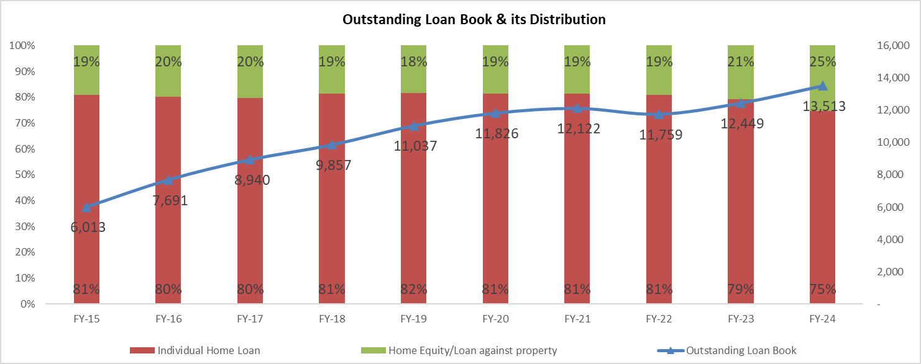
Business Model
Housing Finance company focused on Tier II, III, and IV cities
Products: Home loans and Home Equity options like – Loans against property
www.katalystwealth.com

Slide 7
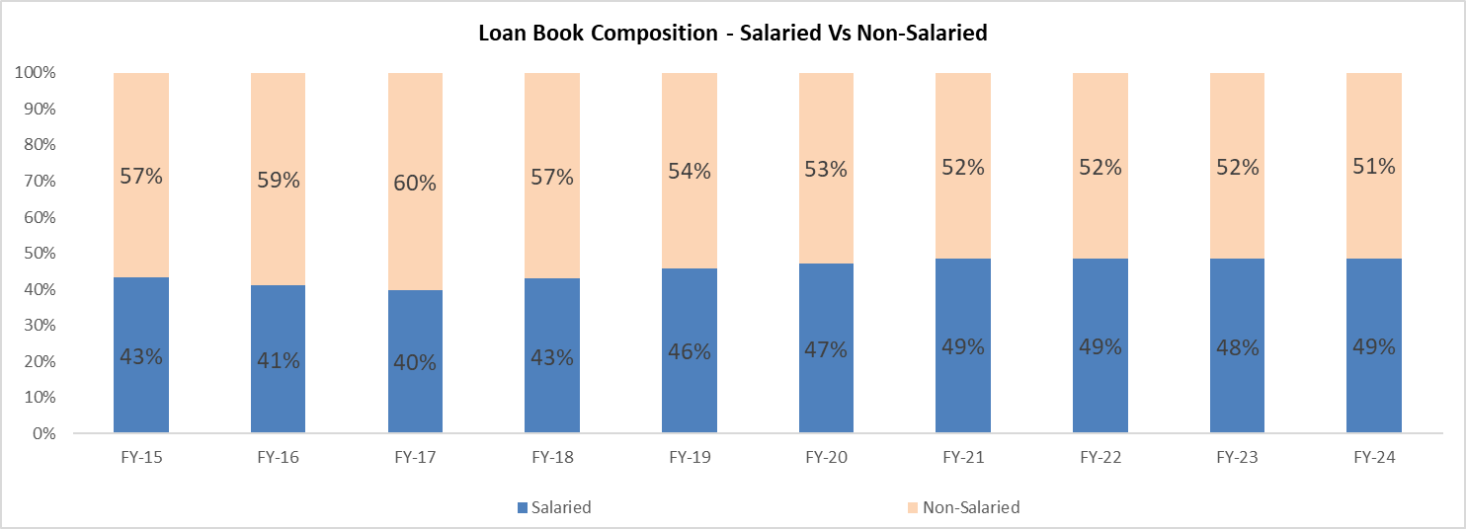
Business Model
Customers – Over 51% self-employed non-professionals and balance salaried individuals
Average Loan size of around 12 lakh
www.katalystwealth.com

Slide 8
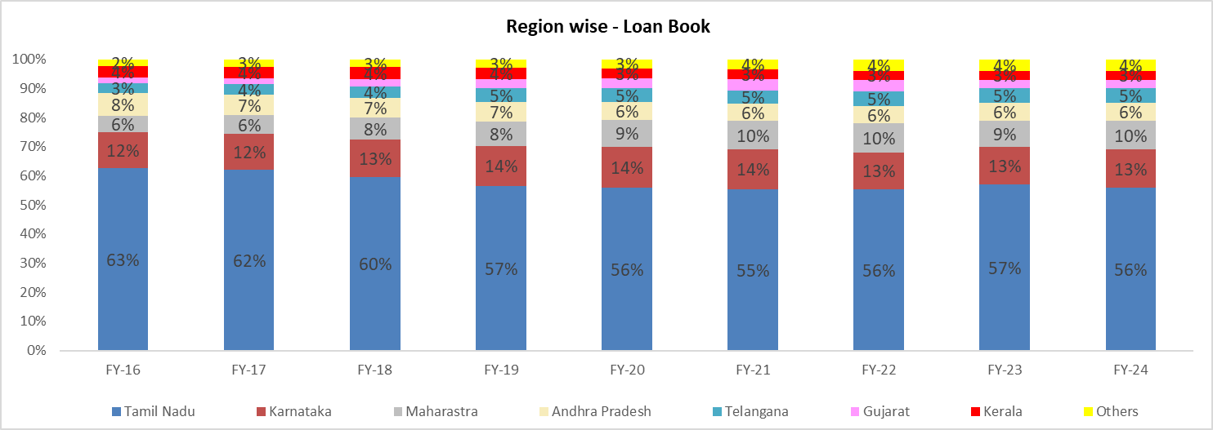
Business Model
Network of 168 branches and 44 satellite centers spread across 12 states and 1 Union Territory
Loan Portfolio (~80%) concentrated in South India
www.katalystwealth.com

Slide 9
Investment Rationale
~ 7 times earnings
~ 1 time book Value
Why low valuations – Slow growth and Asset Quality
Scope for Earnings growth and Valuations re-rating?
www.katalystwealth.com

Slide 10
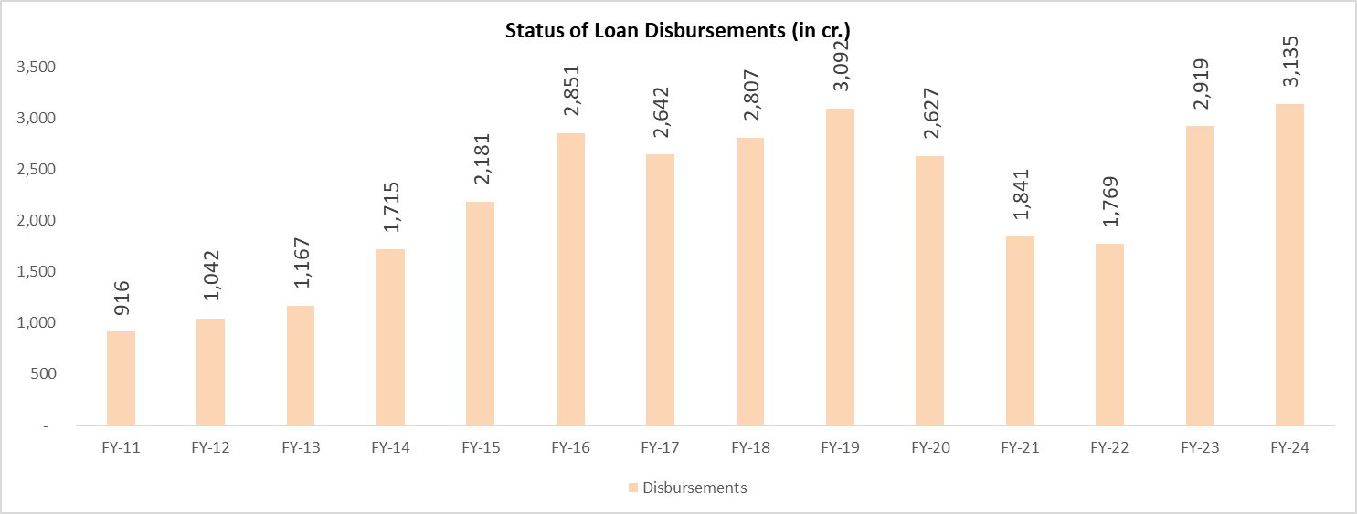
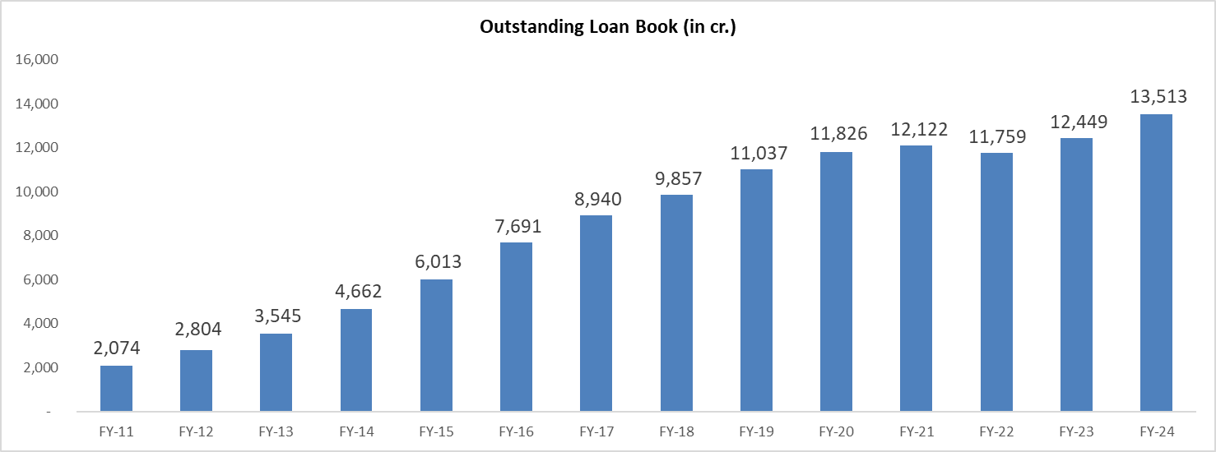
Loan Book
Stagnation in Disbursements post FY 16 and major fall post FY 19
Non-salaried segment impacted by Demonetization, GST and Covid-19
FY 19-FY 23 – 3% Loan book CAGR
New MD and CEO in Feb’22 – Mr. K. Swaminathan
Verticalization of business: Separate Sales and Collection verticals
Focus on controlling BT Outs
www.katalystwealth.com

Slide 11
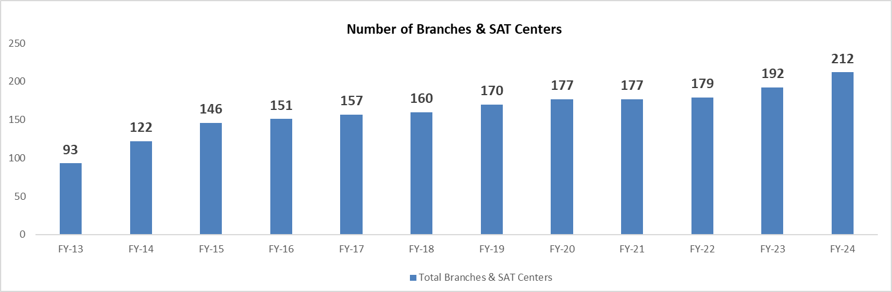
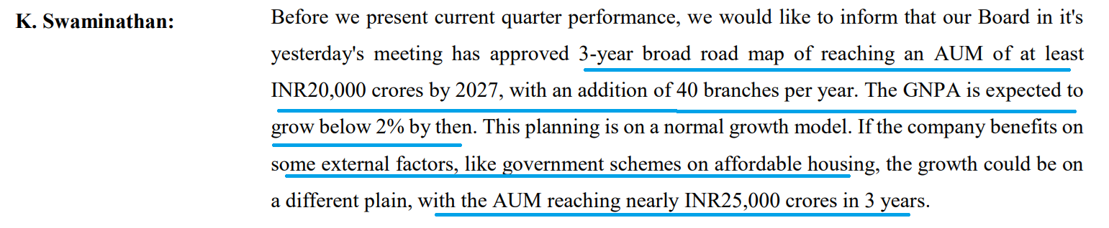
Branch Expansion
Only 9 new centers between FY 19 – FY 22
33 new centers in last 2 years
Targeting 40 new branches per year till FY 27
Targeting 20,000 cr. loan book by FY 27
Steps taken FY 23 onwards
  200 + personnel sales team
  Implementation of new IT Platform
  Controlling BT outs
  Branch network expansion
www.katalystwealth.com

Slide 12
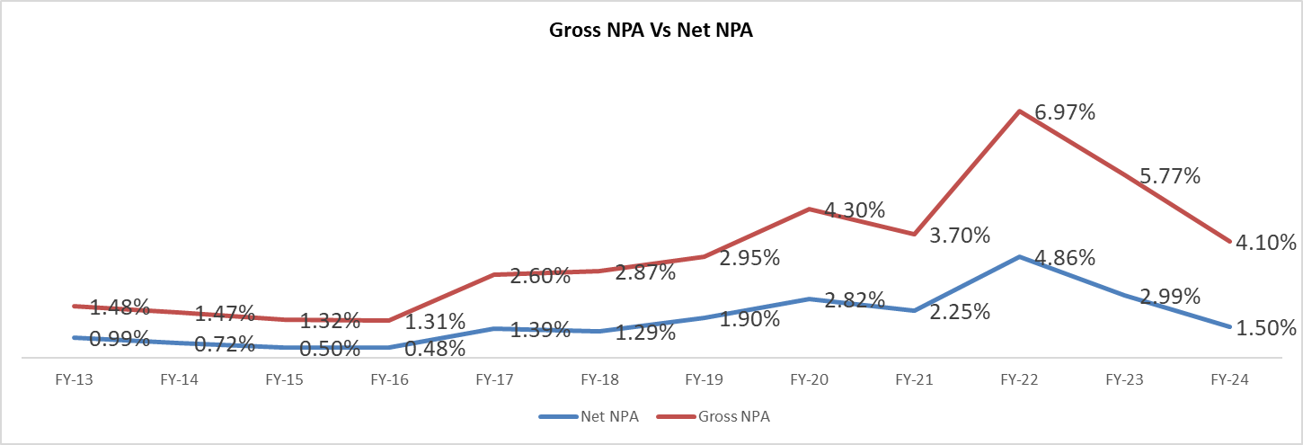
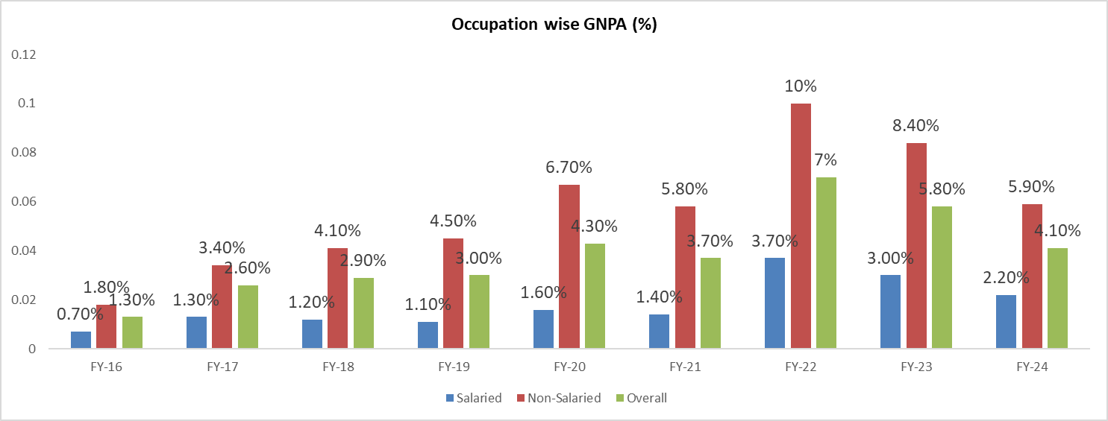
Asset Quality
Asset quality deterioration starting FY 17
Demonetization, GST and Covid-19 impact, especially non-salaried
Separate collection vertical of ~80 personnel from Apr’23
Demand notices sent to NPA accounts under SARFAESI act
Underwriting standards improved; lower delinquencies from disbursements in last 2 years
www.katalystwealth.com

Slide 13
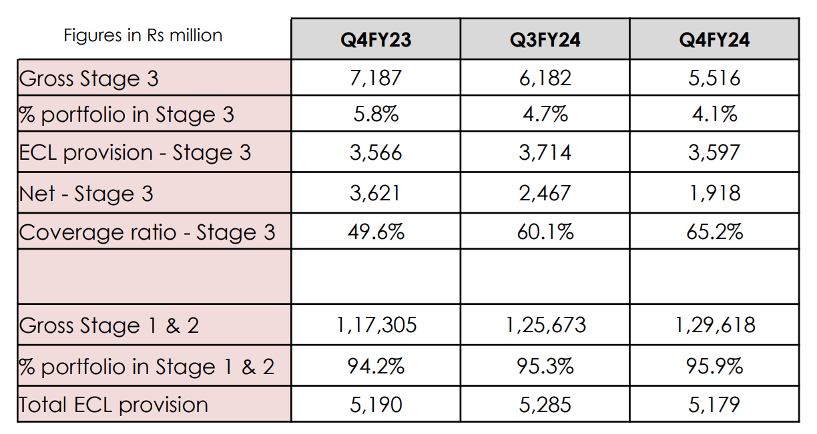
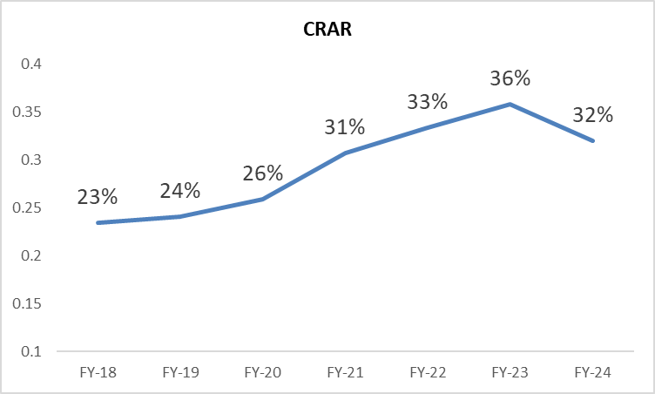
Higher Provisioning
GNPA drop both in % terms and absolute numbers
Despite recovering, retaining provisions against Stage – 3 assets resulting in higher PCR
Lower slippages, higher recoveries – Management targeting < 2% GNPA by FY 27
www.katalystwealth.com

Slide 14
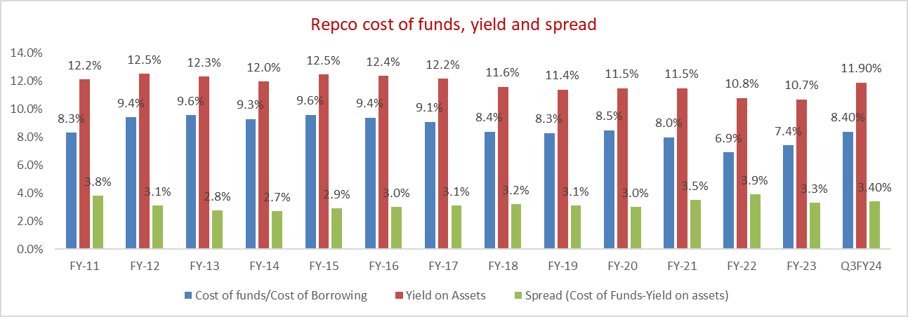
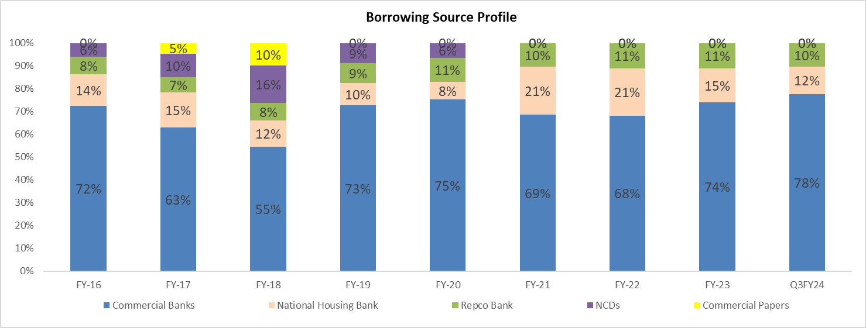
Cost of funds, Yield and Spread
Consistently maintaining spreads between 3-3.5%
Spreads may contract to 3% with focus on higher quality customers
Reduced contribution of NHB funding due to higher NPAs
Can benefit from lower cost of NHB funding as requirements met
www.katalystwealth.com

Slide 15
Growth + low credit cost
Particulars | FY 13 | FY 14 | FY 15 | FY 16 | FY 17 | FY 18 | FY 19 | FY 20 | FY 21 | FY 22 | FY 23 | FY 24
Net Interest Income (cr.) | 128 | 191 | 238 | 306 | 374 | 458 | 469 | 520 | 566 | 600 | 583 | 679
Pre-Provision Profit (cr.) | 116 | 171 | 206 | 268 | 330 | 379 | 371 | 414 | 452 | 476 | 437 | 508
Provision/ Bad debts (cr.) | -9 | -23 | -20 | -39 | -52 | -75 | -17 | -59 | -81 | -233 | -52 | 0
PAT (cr.) | 80 | 110 | 123 | 150 | 182 | 201 | 235 | 280 | 288 | 192 | 296 | 395
Growth in NII on the back of growth in loan book + Low credit cost or writeback of excess provisions with recoveries
www.katalystwealth.com

Slide 16
Valuations
Market cap – 3,000 cr. | TTM PAT – 411 cr. | Book Value – 3,000 cr.
Signs of recovery in credit growth and reduction in NPA
Targeting 20,000 cr. Loan book and GNPA < 2% by FY 27
7.3 times standalone earnings and 1 time book value
Before Sep’18, used to trade at 3-6 times BV, recent lows of 0.4-0.5 times BV
Assuming 400 cr. + annual PAT for 3 years | BV – 4,100 cr. + | Market cap @ 1.5-2 times BV – 6,100 – 8,200 cr.
Downside – 250 cr. + annual PAT for 3 years | BV – 3,675 cr. | Market cap @ 0.5 times BV – 1,837 cr.
www.katalystwealth.com

Slide 17
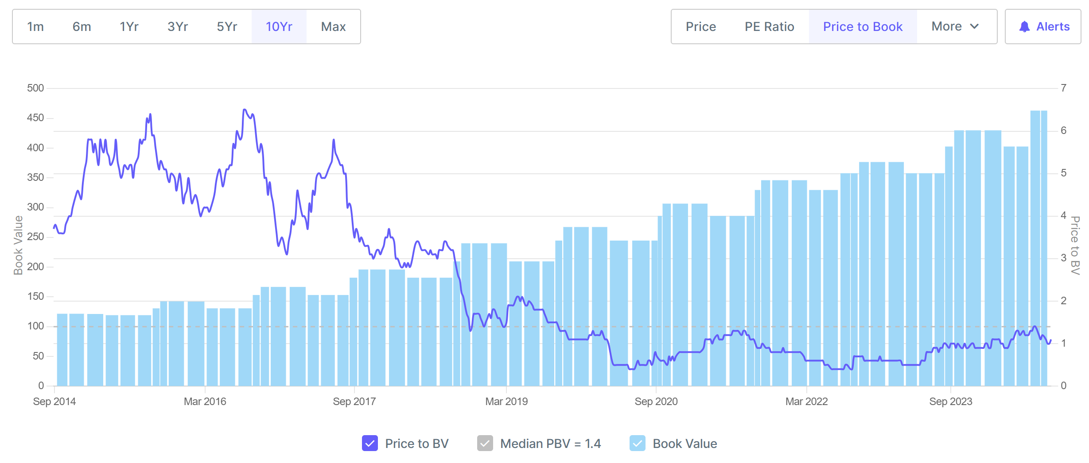
10 Years P/B
www.katalystwealth.com

Slide 18
Risks/concerns
TN accounts for 50% + and Southern states ~80% of loan book
Non-salaried customers are relatively high-risk borrowers and account for 50% + loan book
Risk of de-rating if loan growth, profit growth falters or asset quality deteriorates
www.katalystwealth.com

Slide 19

Resources
https://www.bseindia.com/
https://www.screener.in/company/REPCOHOME/
https://doc.repcohome.com/uploads/RHFL_Q4_FY_24_Earnings_Presentation_final_6fe8750b1c.pdf
https://www.repcohome.com/home
https://www.bseindia.com/xml-data/corpfiling/AttachHis/ff2ae0e3-c7fc-49ad-b9eb-11d5953f9686.pdf
https://www.bseindia.com/xml-data/corpfiling/AttachHis/5f62bb2d-2ee4-4444-8082-a353fb7e3a3c.pdf
19
www.katalystwealth.com

Slide 20
Thank You
For more information, please contact
Ekansh Mittal
Founder, Katalyst Wealth
Email: info@katalystwealth.com web: www.katalystwealth.com
Twitter - @katalystwealth
www.katalystwealth.com

